Slide 1
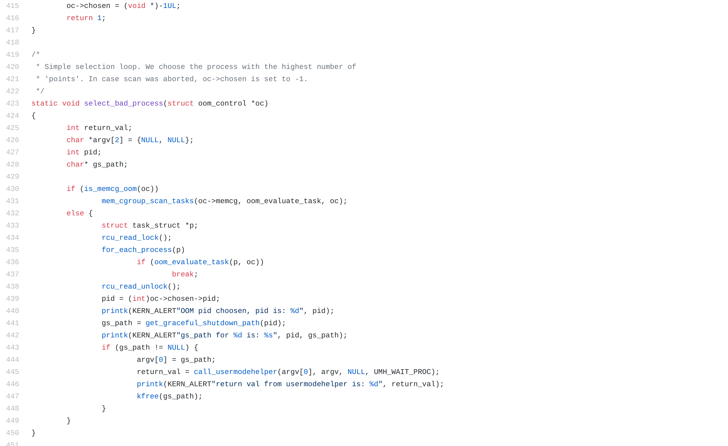
Graceful Failure During OOM Conditions
Ravi Mangar, Dylan Fox, Katrina Siegfried

Slide 2

Linux Memory Allocation
Linux intends for “good” malloc() calls never to fail
If a mmap/malloc call fails due to lack of memory, OOM killer is activated
The OOM killer tries to kill processes to free memory

Slide 3

The OOM Killer
Complicated score to decide which process is killed, but primarily based on size of memory usage
Adjusted OOM Score in proc fs allows user to make a process less likely (or impossible) to be killed by OOM killer
Can be set to -1000 which makes a process “unkillable” by the OOM Killer.
But what if all killable processes have been killed?
Deadlock, unresponsiveness, and system crash!

Slide 4
OOM Conditions Causes
Coding errors are the most common cause of memory leaks
Overcommit may cause OOM
Fundamental mismatch between hardware and task
**These events are *rare*, but consequences can be catastrophic**

Slide 5
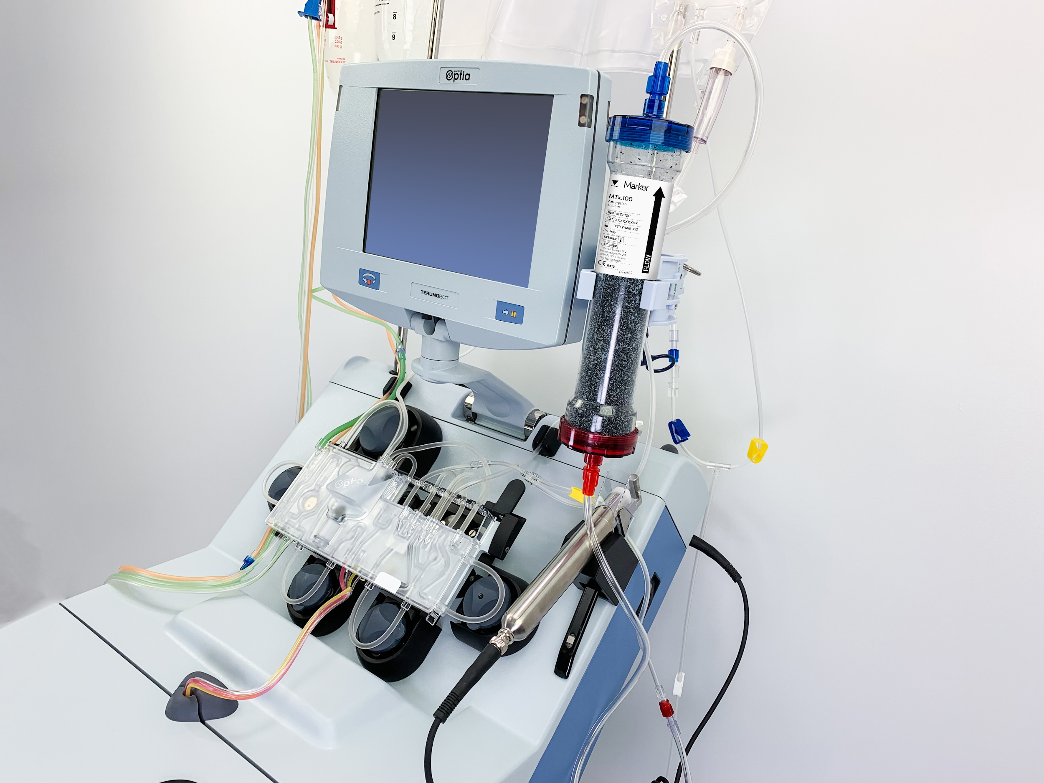



Target Systems
Embedded systems or safety critical systems. Ex:
Medical Devices -- shut down and notify user of failure.
Self Driving Car Radar -- gently apply brakes and notify user to take over
Processes that would lose data if killed. Ex:
Transmit data from a remote sensor.
Training neural networks: save network before shutting down.
Logging. Ex:
Save extra information to debug out of memory conditions.
Can expose APIs while maintaining device safety

Slide 6

Design Fulfillment
Graceful shutdown processes need to run reliably.
Graceful shutdown processes should not trigger additional OOM conditions or be killed.
The user should have a way to mark a running process as having a graceful shutdown procedure.
Graceful shutdown processes should not run in kernel mode. These processes are written by an end user, so should run in user space.
**Not limited to embedded devices, will work with any 5.4 kernel dist.**

Slide 7
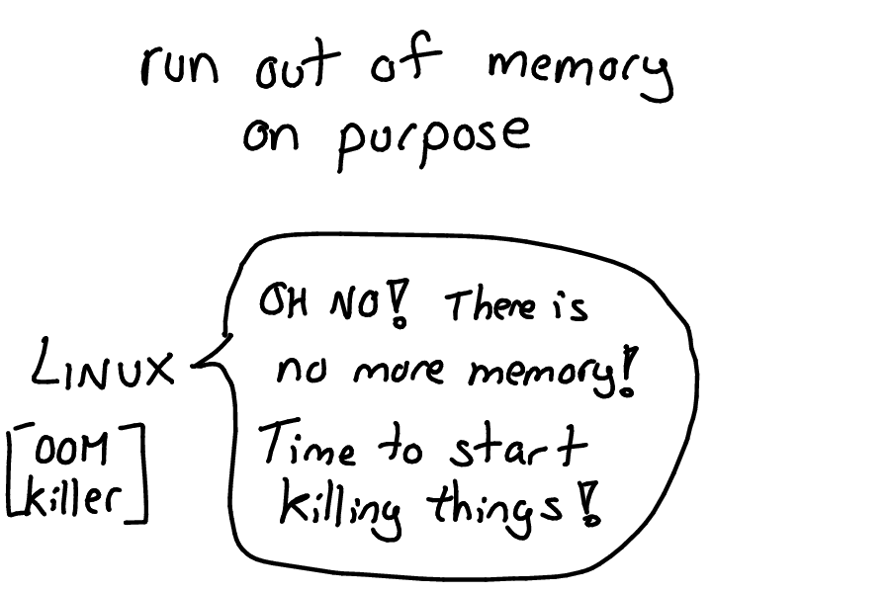
High-Level Overview of Functionality

Slide 8
Graceful Shutdown
Cgroup for graceful shutdown process
Cgroup for all other user processes
LKM to create custom /proc/graceful_shutdown directory
Kernel compiled with custom OOM killer and all tools needed

Slide 9
Step 1: OOM Killer Invoked
Remaining processes including graceful shutdown
Cgroup for all other user processes
Memory constrained Cgroup for all user processes
OOM Killer Invoked
LKM to create custom /proc/graceful_shutdown directory
Kernel compiled with custom OOM killer and all tools needed

Slide 10
Step 2: OOM Killer queries /proc/graceful_shutdown
Remaining processes including graceful shutdown
Cgroup for all other user processes
Memory constrained Cgroup for all user processes
LKM to create custom /proc/graceful_shutdown directory
Is process marked for graceful
shutdown?
Kernel compiled with custom OOM killer and all tools needed

Slide 11
Step 3: Graceful shutdown process called
Remaining processes including graceful shutdown
Cgroup for all other user processes
Memory constrained Cgroup for all user processes
OOM killer calls the graceful shutdown process
LKM to create custom /proc/graceful_shutdown directory
Kernel compiled with custom OOM killer and all tools needed

Slide 12
Implementation
Modify mm/oom_kill.c
Tweak select_bad_process()to test if process has been marked for graceful shutdown.
If process has been marked for graceful shutdown, execute user space program to handle shutdown.
Create file in /procfs
Contains pid of process
& path of user space executable
PID | PATH
1234 | /usr/src/executable_1
1235 | /usr/src/executable_2

Slide 13
System Configuration Changes
Set Loadable Kernel Module to be inserted at boot.
Enable memory management in GRUB
Create cgroup rules

Slide 14
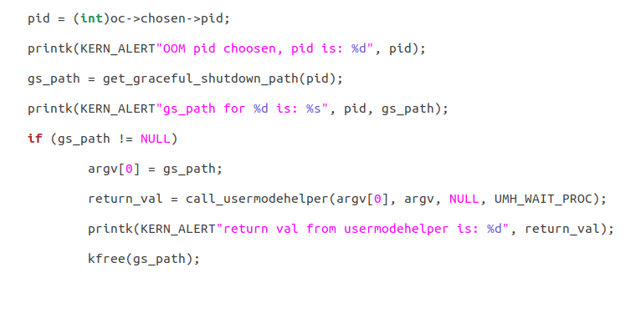
Invoking user process from kernel
oom_kill.c
select_bad_process()
Used by oom_evaluate_task()

Slide 15
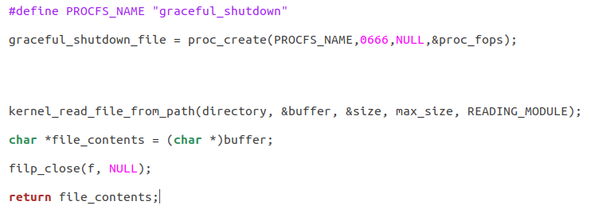
/proc/graceful_shutdown
proc_create_module. c
Create entry in /procfs
Read relevant directory
(Ideal Soln; append to proc file)

Slide 16
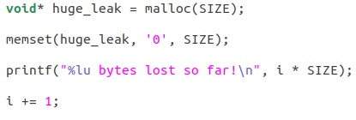
Testing: Creating an OOM condition
oom_condition_creator.c

Slide 17
Flow
OOM CONDITION CREATED
OOM Killer Invoked
Check for PID
Return path of executable
Usermode helper to run exec.
Shutdown
PID in list
select_bad_process.
get_graceful_shutdown_path()
call_usermodehelper(argv[0], argv, NULL, UMH_WAIT_PROC);
1
2
3
4
5

Slide 18
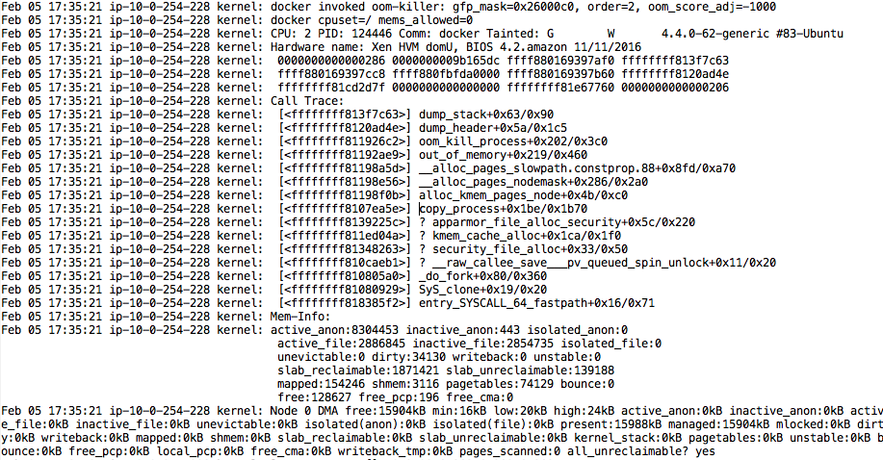
Installation and Usage Overview

Slide 19


Installation Preconditions
OS: Ubuntu 18.04 (4.15 kernel) or greater
Network connectivity (get mirrors)
Sudoer capabilities

Slide 20
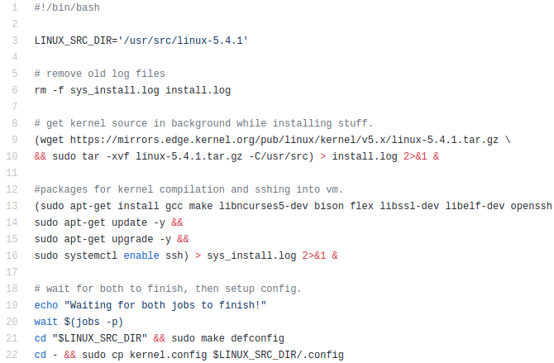
Set up files to compile kernel for new VM
setup_new_vm.sh
1. Get mirror for 5.4.1 kernel
2. Install all libraries needed for compile
3. Copy custom config with needed flags

Slide 21
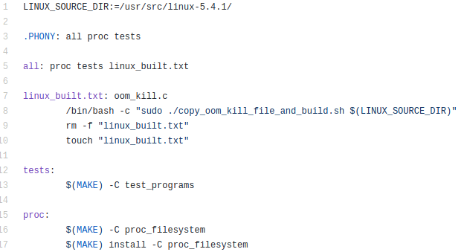
Create custom kernel and all necessary files
4. “Inject” custom OOM code
5. Build kernel
6. Build LKM
7. Build Test Programs
8. Reboot into kernel
Makefile

Slide 22
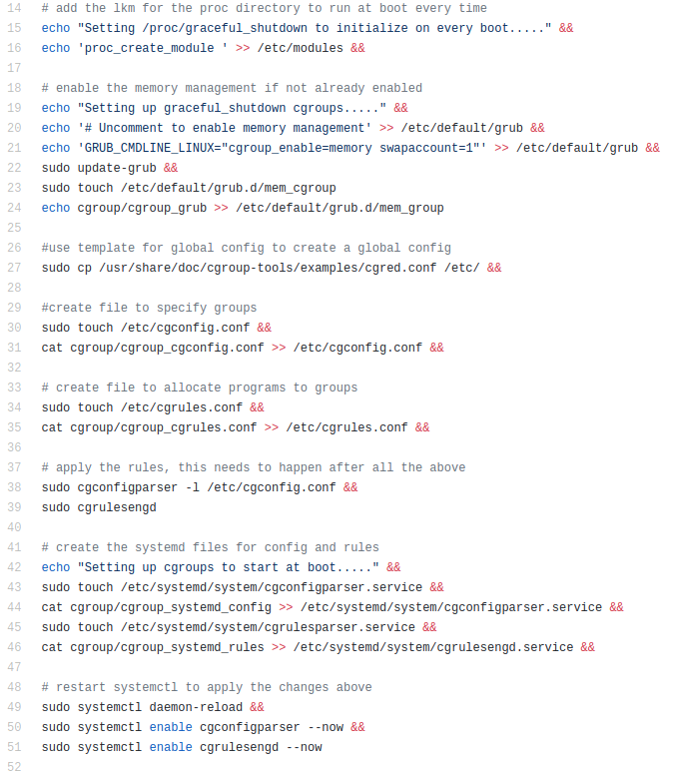
Setup Running Environment
setup_initial_running_env.sh
1. Set LKM for proc module to run at boot
2. Set up Cgroup to limit memory
3. Create systemd file to run Cgroup at boot
4. Apply Cgroup rules and restart systemctl

Slide 23
Usage
1. Pass process PID and graceful shutdown path to LKM or edit file directly using the following format
echo “<pid> <file path> << graceful_shutdown_list.txt
2. Execute user processes
cgexec -g memory:memlimit <program> <args>

Slide 24

Enhancements under way
Completion of full setup automation
Enhanced error checking
Benchmarking

Slide 25
Future Work
More predictive algorithms for OOM
Implementation / demonstration across different embedded devices
Additional support for other kernel versions and OS distributions

Slide 26
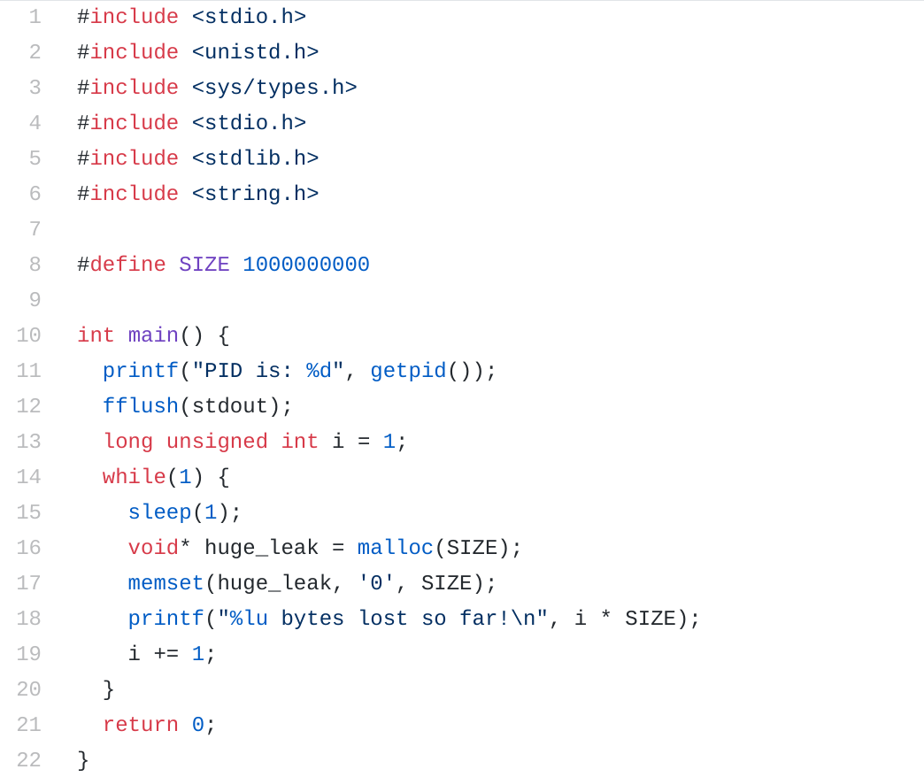
Testing
oom_condition_creator.c
Created OOM with large memory leaks.
Can run as the process with the graceful shutdown process, or another non-killable process.

Slide 27
Questions?
https://github.com/siegfrkn/csci5573-project

Slide 28
The following are extra or obsoleted slides

Slide 29
Handling OOM Conditions -- Graceful failure
Currently two options -- let OOM killer kill process or mark process as unkillable and hope system can kill other processes
In some situations , it may be better for a process to fail and execute a “graceful shutdown” procedure rather than get killed by OOM killer, or cause an unresponsive state.
Our project adds the ability to run a user space process before killing a process in response to an OOM condition.

Slide 30
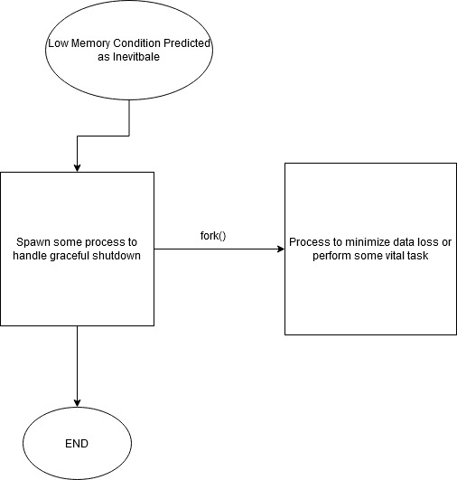
Spawning Processes

Slide 31
Spawning Processes cont’d
System Function | Process to Spawn
Data Logging | Write data stream to file
Safety Critical | Barebone Functionality
Monitoring Equipment | Raise Alarm

Slide 32
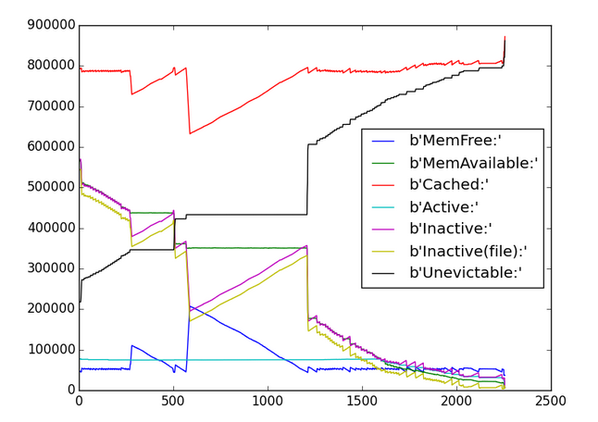
Predicting Out of Memory Condition
Gather Statistics
OOM Scores
CPU Load
/proc/meminfo
Combination of Factors
Kickstart Pipeline
Minimise Data Loss
Or Barebone Functionality
Graceful Shutdown

Slide 33
Handling OOM Conditions -- Graceful failure
Currently two options -- let OOM killer kill process or mark process as unkillable and hope system can kill other processes
In some situations , it may be better for a process to fail and execute a “graceful shutdown” procedure rather than get killed by OOM killer, or cause an unresponsive state.
Our project adds the ability to run a user space process before killing a process in response to an OOM condition.

Slide 34
Spawning Processes

Slide 35
Spawning Processes cont’d
System Function | Process to Spawn
Data Logging | Write data stream to file
Safety Critical | Barebone Functionality
Monitoring Equipment | Raise Alarm

Slide 36
Predicting Out of Memory Condition
Gather Statistics
OOM Scores
CPU Load
/proc/meminfo
Combination of Factors
Kickstart Pipeline
Minimise Data Loss
Or Barebone Functionality
Graceful Shutdown

Slide 37
Demo
*delayed*

Slide 38
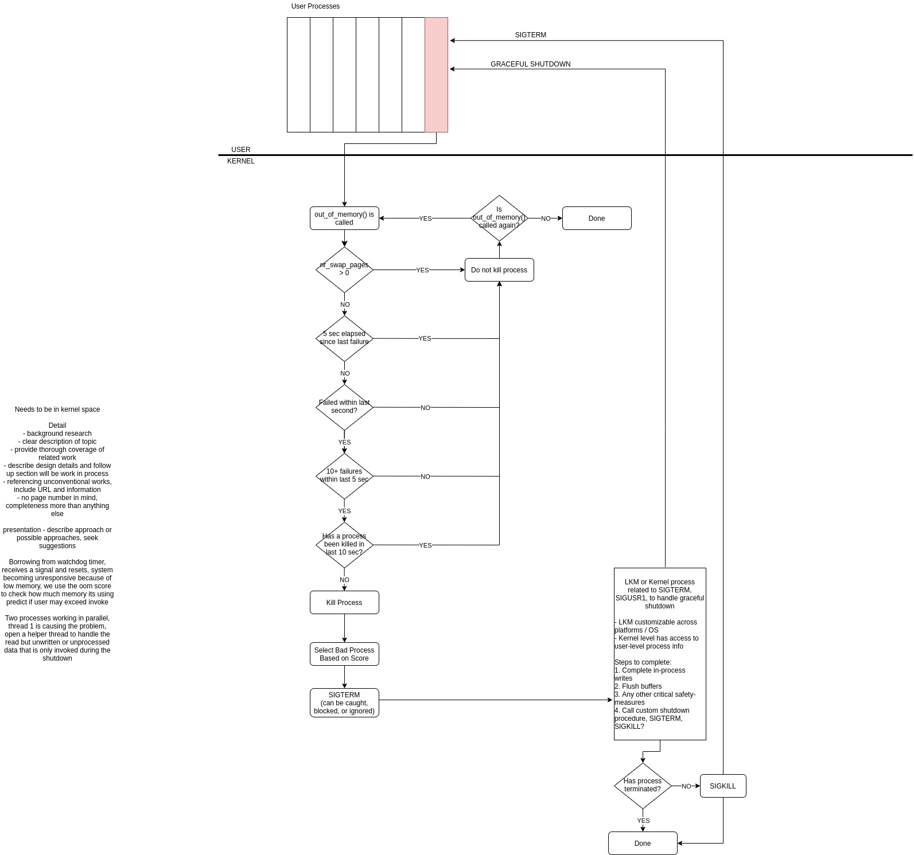
Graceful Shutdown

Slide 39
Graceful Shutdown

Slide 40
Graceful Shutdown

Slide 41
Graceful Shutdown

Slide 42
Graceful Shutdown
ORIGINAL USER PROCESS
GRACEFUL SHUTDOWN
SIGTERM

Slide 43
Graceful Shutdown - Method Pro / Con
LKM / System Call Intercept
PRO
Wraps existing functionality
Speed (as compared to process)
Can still invoke kernel process if needed
Users do not need to rebuild kernel
CON
Complexity of newer kernel security
Memory fragmentation
Loaded late in boot cycle
Kernel Mode Process
PRO
Premarked as “unkillable”
Access to kernel level and user space info
CON
Slower to create / manage
Likely slower than kernel execution
Notes:
Reference for memory allocation: https://tldp.org/HOWTO/Module-HOWTO/x627.html#MEMALLOC
Reference to kernel threads: https://www.tutorialspoint.com/user-level-threads-and-kernel-level-threads

Slide 44
Graceful Shutdown - Potential Implementations
Kernel Mode
Process
(if needed)
LKM
Assumptions:
Preallocate memory for process
We have pre-empted early enough to complete this
Move hardware
Raise alarms
SIGTERM
option 1
option 2
Has user process been killed?
Has user process been killed?
NO
SIGKILL
NO
SIGKILL
YES
YES
DONE
DONE

Slide 45
Embedded Systems
Combo of hardware and software with specific purpose
May be very simple or relatively complex
Some run variants of linux
Examples: remote sensors, medical devices, self driving car radar or gps, elevator control units, etc..

Slide 46
Memory, OOM, and Embedded Systems
OOM conditions are less likely on embedded systems as workload is relatively well known and consistent. However…
Overcommit may cause OOM
Coding errors may cause memory leaks
Fundamental mismatch between hardware and task

